Slide 1
MODULE 2: BASELINE ASSESSMENT
Session 7: Seasonal Calendars
Notes:
Seasonal Calendars

Slide 2
Purpose and content
To describe the importance of seasonality in livelihoods analysis and to introduce seasonal calendars as a basic tool for gathering HEA information.

Slide 3
By the end of session you should be able to:
• Describe what a seasonal calendar is and why it is necessary in HEA for both baseline- and outcome analysis
Construct a seasonal calendar from an interview with key informants

Slide 4
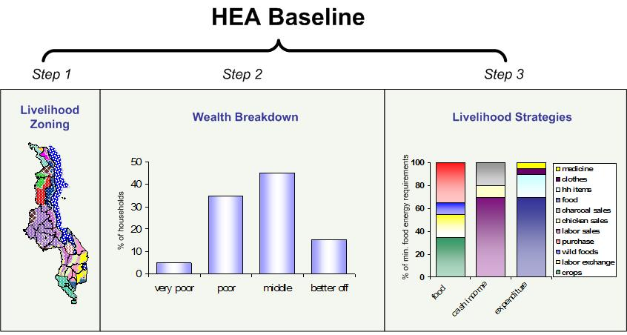
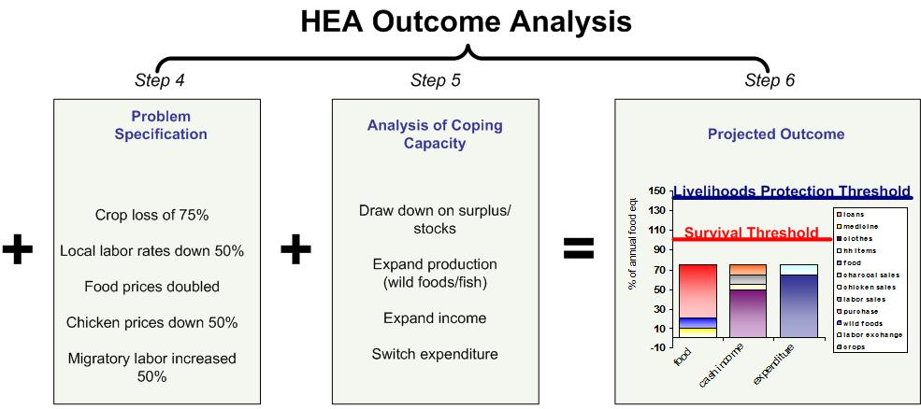
Where do seasonal calendars fit?
Seasonal Calendars capture variations in access that occur throughout a typical year
Session 7: Seasonal Calendars
Notes:
Seasonal Calendars

Slide 5
What is a seasonal calendar?
Seasonal Calendars are:
A graphic representation of key production, market-related and other activities as they occur throughout the year
Session 7: Seasonal Calendars
Notes:
Seasonal Calendars

Slide 6
Why do we need seasonal calendars?
They:
help analysts draw correlations between different activities
highlight potential areas of competition for labour, resources, etc.
provide guidance for monitoring and response frameworks
Session 7: Seasonal Calendars
Notes:
Seasonal Calendars

Slide 7
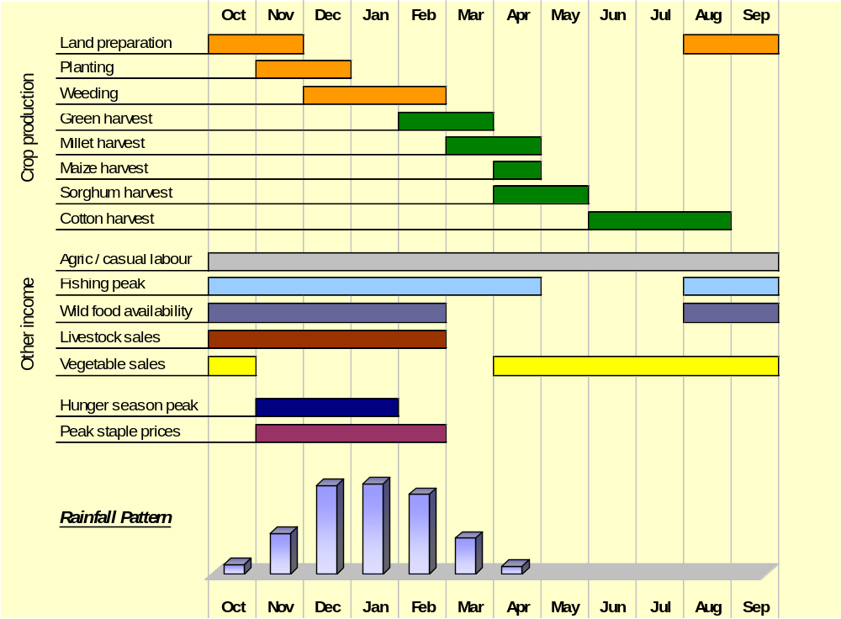
Why do we need seasonal calendars?
To understand when different sources of food are available
Session 7: Seasonal Calendars
Notes:
Seasonal Calendars

Slide 8
Why do we need seasonal calendars?
To understand when different sources of income are available
Session 7: Seasonal Calendars
Notes:
Seasonal Calendars

Slide 9
Why do we need seasonal calendars?
To understand when different crops are planted/harvested
Session 7: Seasonal Calendars
Notes:
Seasonal Calendars

Slide 10
Why do we need seasonal calendars?
To understand when prices normally peak
Session 7: Seasonal Calendars
Notes:
Seasonal Calendars

Slide 11
Why do we need seasonal calendars?
To understand potential areas of competition between activities
Session 7: Seasonal Calendars
Notes:
Seasonal Calendars

Slide 12
Why do we need seasonal calendars?
Understanding seasonality can help in the design of appropriate responses
In an HEA assessment in post-earthquake Pakistan, a seasonal analysis of income showed that….
Session 7: Seasonal Calendars
Notes:
Seasonal Calendars

Slide 13
Why do we need seasonal calendars?
…the poor and very poor normally rely exclusively on credit to obtain cash from December to February.
Helping local shopkeepers re-establish themselves was one way to help the poor survive over the winter.
Session 7: Seasonal Calendars
Notes:
Seasonal Calendars

Slide 14
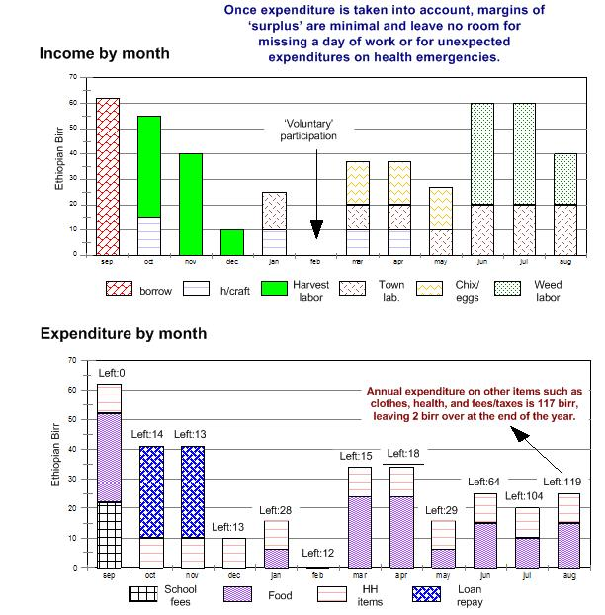
Why do we need seasonal calendars?
Detailed seasonal income/expenditure analyses can help highlight particular times of hardship and constraint
Session 7: Seasonal Calendars
Notes:
Seasonal Calendars

Slide 15
In Short
Seasonal calendars are necessary for three reasons:
They are the basic device for storing and analysing information on seasonal variations in food, income and expenditure

Slide 16
In Short
They provide a useful tool for information collection in general, because they tend to get informants involved and can help people open up and feel more comfortable. They convey information that everyone (literate and non literate) can understand and assess, and can encourage the participation of a wide group of informants.

Slide 17
In Short
They provide a useful cross-check on annual food and income. Breaking things down and adding them up again can add confidence and reliability to your results.

Slide 18
How to do it
Seasonal calendars can be constructed in the same way as a community map, using local materials such as sticks, stones, leaves, branches, bricks and rocks. So you need first of all to gather together these materials. Alternatively, you can use flipchart paper.

Slide 19
How to do it
Begin by defining the seasons in that area. Try to match seasons to the Gregorian calendar, but use local names in discussion if relevant.
Place items representing the seasons horizontally along the bottom of the paper or the ground.

Slide 20
How to do it
Down the side - in the ‘vertical’ column - list activities or items according to the type of calendar you are trying to construct, such as rainfall, weeding, planting, migration for employment, livestock sales.

Slide 21
How to do it
Begin the discussion by asking informants when an activity normally takes place. Establish when it begins and ends. Mark the period on the ground or paper with materials collected.

Slide 22
How to do it
During this process you should also establish who is doing the activity. Make sure age and gender are specified.
Continue asking questions until you have exhausted the list in the vertical column.
Summarise findings and clarify any outstanding questions with informants before ending the interview.

